Slide 1






Managing Organic Waste
Utilizing the Potential of Organic Waste
for a Cleaner Environment

Slide 2




Introduction
Organic waste is an environmental problem that urgently needs to be resolved. Every year, millions of tonnes of organic waste are generated worldwide. From food scraps to leaves, organic waste affects the environment.

Slide 3


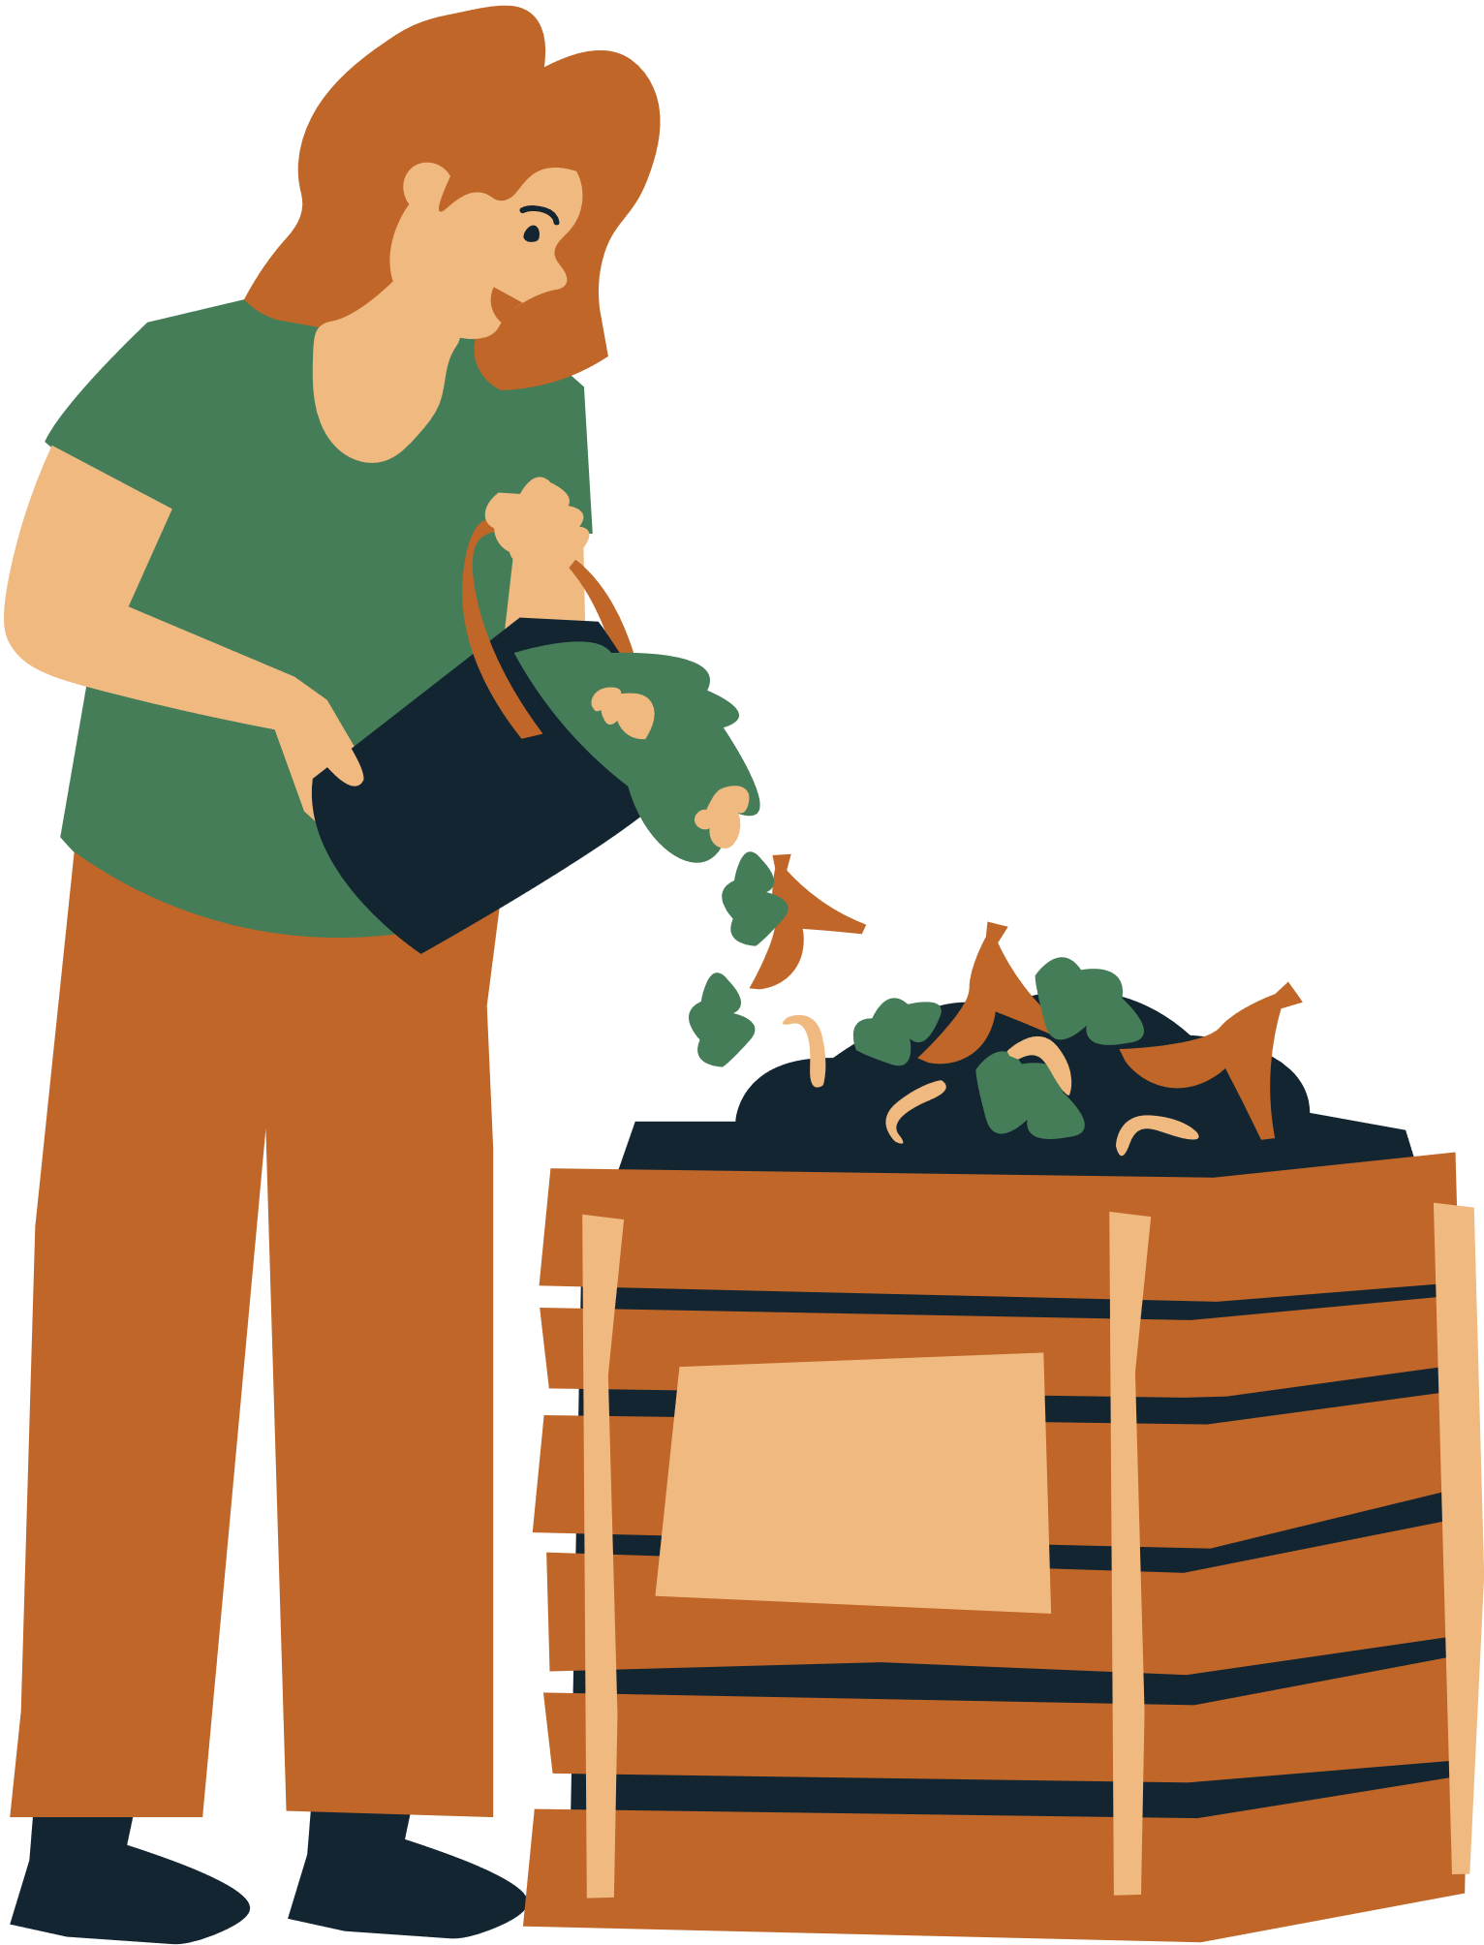

Why is it Important to
Manage Organic Waste?
By managing organic waste wisely, we can minimize its negative impacts and even turn it into a valuable resource. Let's explore more about practical steps to manage organic waste.

Slide 4



Step 1
Waste Sorting
Waste sorting is an important first step in managing organic waste. By separating organic waste from non-organic waste, we can start the management process effectively.

Slide 5



Step 2
Compost is a natural process of turning organic waste into nutrient-rich fertilizer for plants. Following are the steps in making compost:
Compost
Compost Making Process:
Choose a suitable compost container or place, such as a compost bin or open pile.
Mix various organic materials, such as food scraps, leaves and dry grass.
Ensure proper humidity by sprinkling water if necessary.
Turn or stir the compost pile regularly to ensure adequate air ventilation.
Wait several weeks or months until the organic material decomposes into mature compost.

Slide 6
Step 3
Composting at Home
Composting at home is a practical way to manage organic waste and produce quality compost. Here are the steps:
Home Composting Process:
Choose the right location in your yard or garden for the compost bin.
Stir the pile regularly to ensure even decomposition and speed up the process.
Start with a layer of organic material such as food scraps and dry leaves.
Let the composting process continue for several weeks or months until the compost is mature.
Continue adding layers of organic material alternating with layers of soil or mature compost.

Slide 7



Step 4
Biofermentation is another effective method for processing organic waste into useful fertilizer. Here are the steps:
Uses of Biofermentation
Collect organic materials such as food scraps, leaves, or straw in a closed container.
Add water and food additives to speed up the fermentation process.
Let the mixture ferment for several weeks under closed conditions.
Filter the fermented liquid to obtain liquid organic fertilizer that is ready to be used.

Slide 8
Conclusion
Organic waste management is an important step in promoting a cleaner, healthier and more sustainable environment.

Slide 9

“Let's take action together to manage organic waste wisely for the sustainability of our environment and future generations”

Slide 10

Thank You

